Slide 1
1
08/02/2023

Slide 2
A sustainable future for the North
Dounreay team:
Head of Sustainability and Socio Economics - David Calder
Socio Economics Manager - Magnus Davidson
Sustainability Manager - Emily Kearl
Socio Economic Administrator – Dawn Clasper
Sustainability pillars: Social, economic, environmental, (cultural)
NDA transforming legacies: Decommissioning, environmental, socio-economic, cultural
Focus today will be on social and economic development underpinned by environmental challenges and opportunities
2
08/02/2023
Notes:
Safety – no tests
Photos

Slide 3
Underpinning challenges
Regional area population projections 2016 to 2041
Region | Number | Percentage
Caithness | -5,440 | -21.1%
Sutherland | -1,627 | -11.9%
Easter Ross | -2,986 | -13.8%
Ross and Cromarty | +804 | +8.7%
Mid Ross | +2,897 | +12.2%
Inverness | +9,035 | +11.2%
Skye and Lochalsh | +1,551 | +11.8%
Nairn | +874 | +6.6%
Lochaber | -1,160 | -5.9%
Badenoch and Strathspey | -730 | -5.3%
Environment:
Climate and nature crises
Economy:
Recession and weak recovery
Society:
Demographic change
Healthcare, connectivity, transport, increasing inequality, fuel poverty, inflation
Varied timeframes
3
08/02/2023
Notes:
Safety – no tests
Photos

Slide 4
Focus North – Energy rich
Producing 1,240% of electricity consumption from large onshore wind, ~0.5GW
Additional offshore wind resource:
~1.5GW operational,
~0.8GW under construction or in planning
6.5GW ScotWind
World’s largest tidal stream array:
6MW operating
28MW with CfD
52MW consented
312MW in planning
Green hydrogen production in planning
BOWL
4
08/02/2023
Notes:
Safety – no tests
Photos

Slide 5
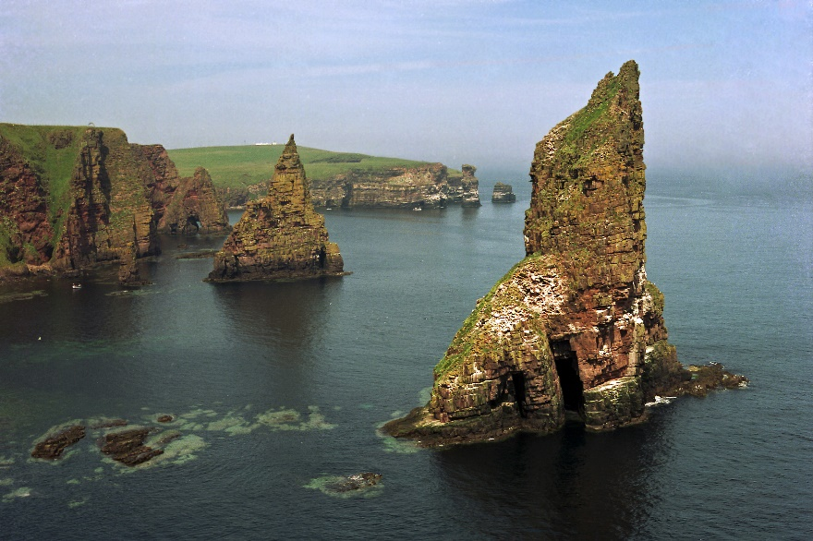
Focus North – Rich in natural capital
Carbon storage and sequestration:
400 million tonnes (2x total British woodland carbon)
Restoration – voluntary carbon offset market
‘Flow Country’ UNESCO World Heritage Site
NC500 - £23m GVA in 2018
High latitude - space industry
NC500
5
08/02/2023
Notes:
Safety – no tests
Photos

Slide 6
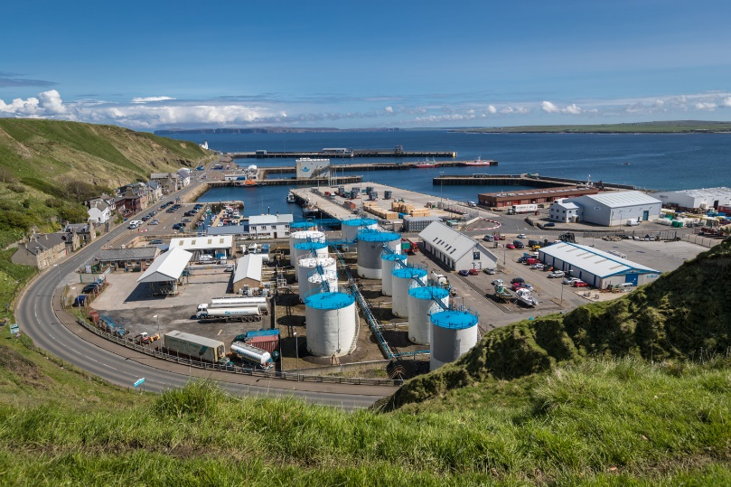
Focus North – Rich in people and places
Highly skilled workforce – nuclear, renewables, oil and gas, engineering, energy storage
Infrastructure – ports, airport, railway, ferry links, college, university, research capacity
SCRABSTER HARBOUR
6
08/02/2023
Notes:
Safety – no tests
Photos

Slide 7
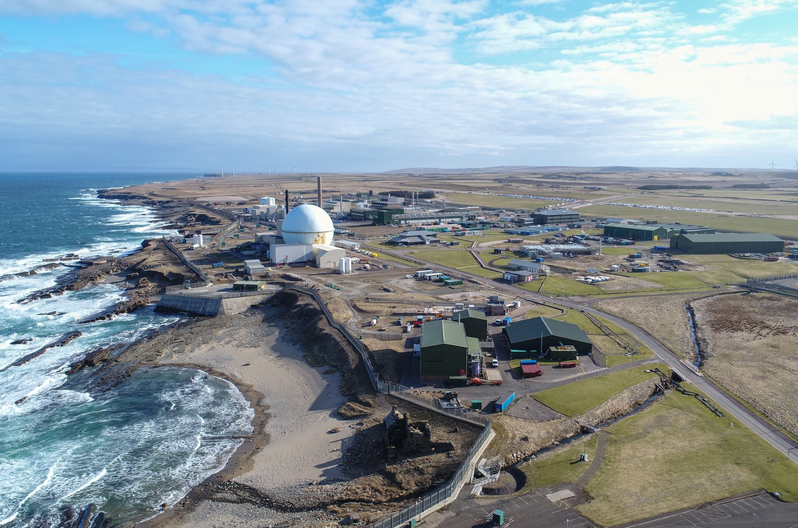
What About Dounreay?
“By the site’s interim end state, DSRL will have prepared and supported its workforce to transition into sustainable alternative employment.”
Contribute to maintaining and developing skills in the area
Contribute to the economic and social infrastructure of the area
Support the diversification of local economies into other sectors
7
08/02/2023
Notes:
Safety – no tests
Photos

Slide 8
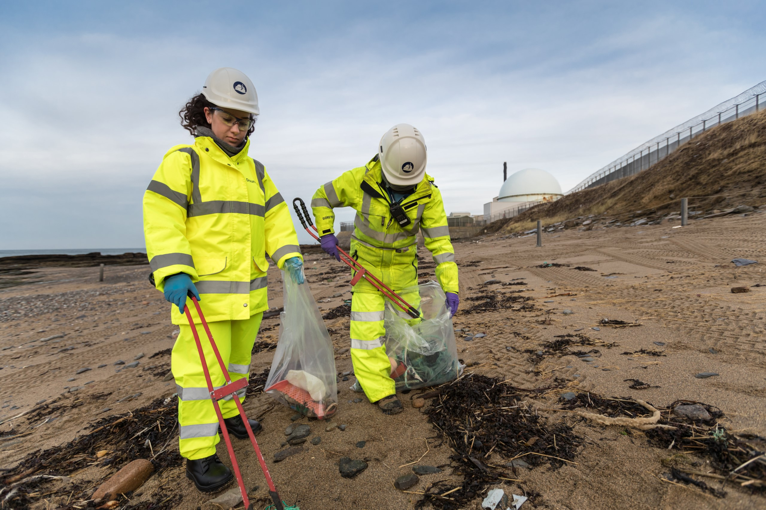
Dounreay socio economic activity
Dounreay socio economic budget:
Focus North
CCoC projects
PSO officer
Venture North
North Coast Visitor Centre
Caithness Transport Forum
STEM activity
And more…
Caithness and North Sutherland Fund
Dounreay Communities Fund
8
08/02/2023
Notes:
Safety – no tests
Photos

Slide 9
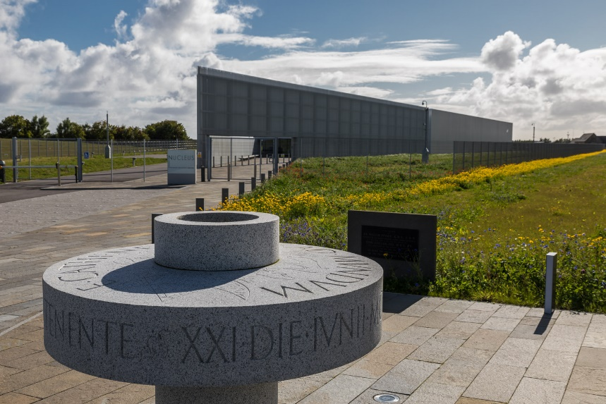
NDA socio economic impact in C&S
North Highland Regeneration Fund
£2.5m loans for start-ups and business growth
Caithness Business Fund –
COVID-19 recovery
Nucleus, the Nuclear and Caithness Archives
£21m investment from NDA
Scrabster harbour upgrades
£5m funding for St Ola Pier
9
08/02/2023
Notes:
Safety – no tests
Photos

Slide 10
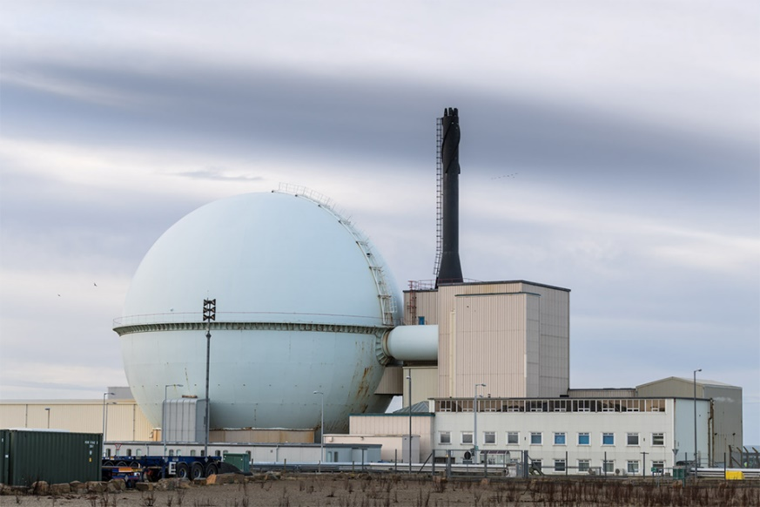
Dounreay’s 2022 C&S impact
Direct employment of 1,283:
96% Caithness
2% Sutherland
2% rest of UK
Direct ‘labour only’ GVA:
£57.6m
Indirect ‘labour only’ GVA:
£10.5m supplier
£9.3m agency staff
Total ‘labour only’ GVA
£77.4m
*Excludes non-labour inputs (capital, land, taxes)
10
08/02/2023
Notes:
Safety – no tests
Photos

Slide 11
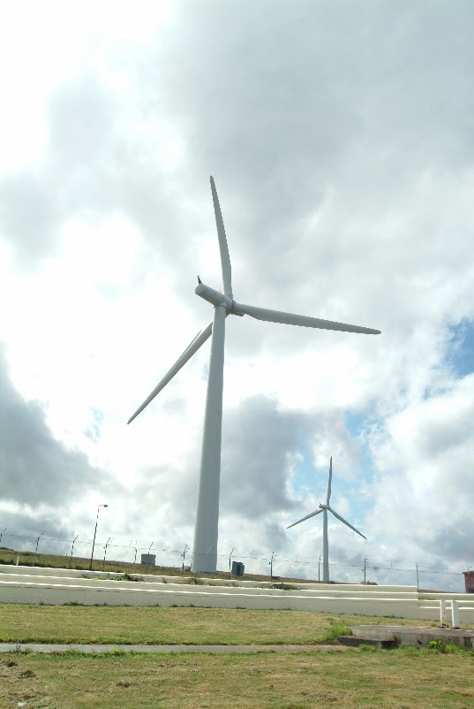
Focus North – Just transition
Energy Act 2004 – NDA socio economic activity
Climate Change (Scotland) Act 2019 – Just Transition
Similar challenges and opportunities in nuclear decommissioning transition
Stimulate a just transition for:
Dounreay workforce
Dounreay supply chain
Wider area
11
08/02/2023
Notes:
Safety – no tests
Photos

Slide 12
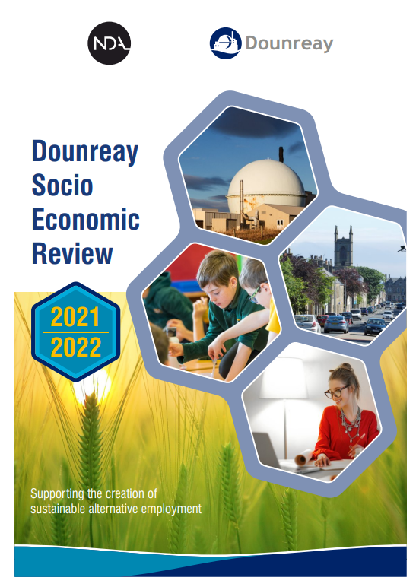
Focus North – Sustainable future
Sustainability: Social, economic, environmental
Focus North area is incredibly well (unrivalled?) situated for net-zero transition
Dounreay funds:
Socio economic activity which drives the transition to net-zero industries
discrete social development activity
A core component of Dounreay activity can be consider under Just Transition umbrella
12
08/02/2023
Notes:
Safety – no tests
Photos

